Slide 1

School of Computing
Vel Tech Rangarajan Dr. Sagunthala R&D Institute of Science and Technology
Department of Computer Science and Engineering
10211CS224 / FULL STACK APPLICATION DEVELOPMENT (JAVA)
PROJECT REVIEW : MILESTONE PROJECT – 1
Date: 02-02-2026
END TO END EVENT LIFE CYCLE & TICKETING PLATFORM
SDG: SDG No –9 (Innovation and Infrastructure)
Presented By:
G V Lokesh Reddy– VTU26455– Reg.No.23UECS0964
Courses Handling Faculty: Dr. S . HEMAMALINI – M.E., Ph.D.,

Slide 2
INTRODUCTION
1
A ticketing system is a software platform designed to manage and track requests, issues, or tasks efficiently.
It enables users to submit tickets through multiple channels such as email, web portals, chat, or phone.
he system automates routing, assignment, and prioritization based on predefined workflows and SLA rules.
Agents can collaborate internally, update tickets, and communicate with users within the platform.
A centralized database stores all ticket details, user information, communications, and attachments.
2
3
4
5
6
7
he system provides analytics and reporting to monitor performance, track SLA
8
compliance, and identify trends.
By streamlining the ticket lifecycle, it reduces resolution time and improves productivity. Overall, it enhances user satisfaction and supports data-driven decision-making for organizations.
9

Slide 3
PROBLEM STATEMENT
Organizations handle a large volume of requests and issues from multiple channels like email, chat, and phone..
Manual ticket management often leads to delays in assignment and resolution
Lack of centralized tracking causes tickets to be lost or overlooked..
Inefficient workflows increase workload on support staff and reduce productivity..
SLA compliance and priority handling are difficult to enforce manually.
Limited reporting and analytics make it hard to identify recurring issues or performance gaps.
Hence, Customer satisfaction drops due to slow responses and poor com
The proposed system aims toautomated, centralized ticketing system to streamline the full lifecycle from creation to closure.
1
2
3
4
5
6
7
8
9

Slide 4
OBJECTIVES
✅ 1. Automate Event Management
Enable administrators to create, update, and delete events.
Store event details in a centralized database.
✅ 2. Enable Online Ticket Booking
Allow users to book tickets through a simple web interface.
Provide real-time ticket availability updates.
✅ 3. Prevent Overbooking
Implement ticket validation logic.
Automatically deduct tickets after successful booking.
✅ 4. Ensure Secure User Access
Implement login and role-based access control.
Restrict admin operations to authorized users.
✅ 5. Maintain Booking Records
Store booking details systematically.
Track user name, tickets booked, and total amount.
✅ 6. Generate Reports & Analytics
Calculate total tickets sold.
Monitor revenue generation.
Analyze event performance.
1
2
3
4
5
6
7
8
9

Slide 5
PROPOSED SYSTEM
To provide a centralized, automated, and efficient platform for managing tickets from creation to closure, improving response time, tracking, and reporting.
Data-driven insights for continuous improvement
Stores tickets, users, agent info, communication logs, attachment
Supports reporting, analytics, and audit trails
ntelligent routing and assignment to agents/teams
Email, web portal, chat, phone, mobile app.
Capture user details, issue description, priority, and attachments
Automation reduces manual effort
Scalable and integrable with CRM/ERP systems
1
2
3
4
5
6
7
8
9

Slide 6
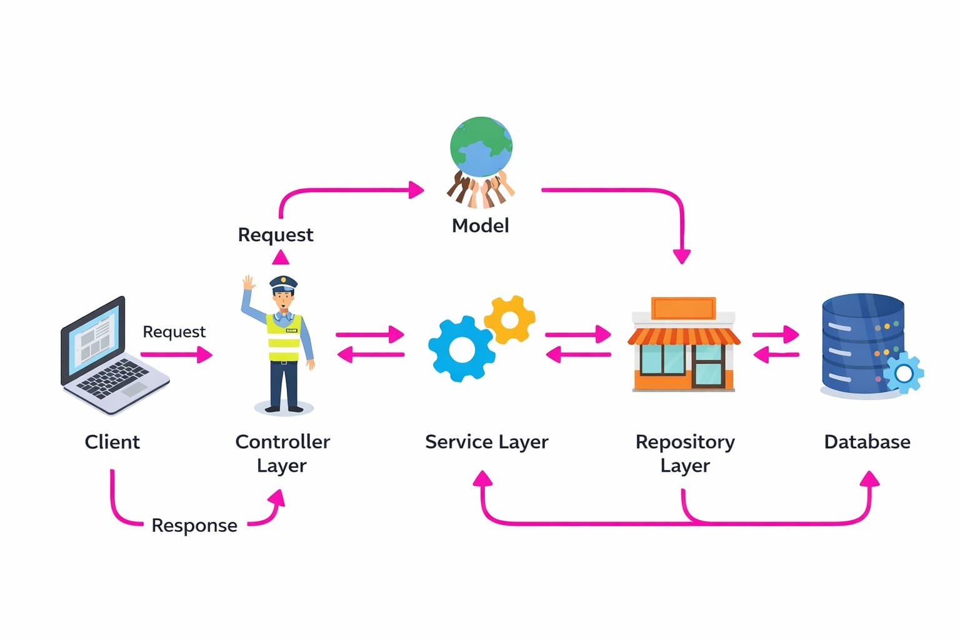
PROPOSED SYSTEM ARCHITECTURE
1
2
3
4
5
6
7
8
9

Slide 7
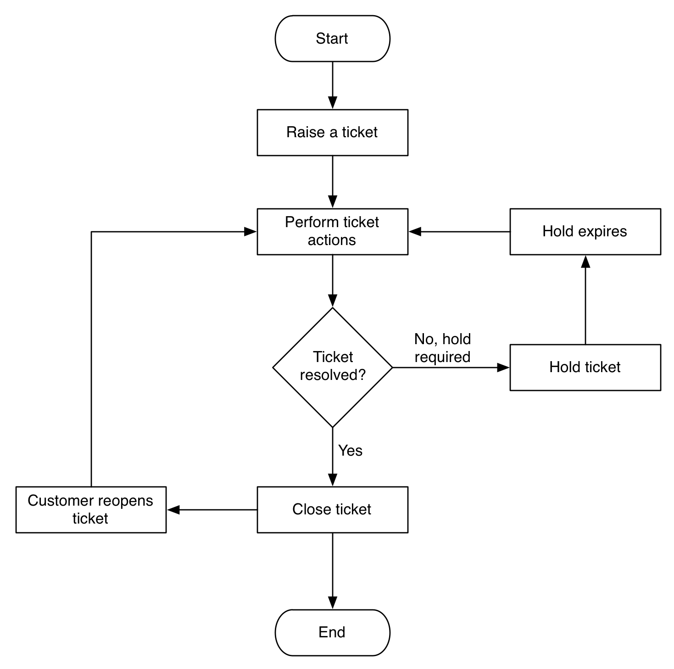
WORKFLOW
1
2
3
4
5
6
7
8
9

Slide 8
TECHNOLOGIES USED
Frontend:
HTML, CSS, JavaScript (for user interface and responsive design).
Backend:The backend of an end-to-end ticketing platform handles business logic, ticket processing, user management, integrations processing.
Database:
tickets, users, workflows, communications, and analytics data for efficient management and reporting.Tools:
VS Code / Eclipse IDE, XAMPP or Apache Tomcat Server, Git for version control.
Hardware/Software Requirements:
Minimum 4GB RAM, Dual-Core Processor, Windows/Linux OS, Web Browser (Chrome/Edge/Firefox), Stable Internet Connection.
1
2
3
4
5
6
7
8
9

Slide 9
MODULE DESCRIPTION
📘 Module 1: User Management Module
The User Management Module is responsible for handling user registration, authentication, and role-based access control (Admin/User). It ensures that only authorized users can perform specific actions within the system.
🎟️ Module 2: Ticket Management & Workflow Module – Evaluation
The Ticket Management & Workflow Module is responsible for handling the complete ticket booking lifecycle. It manages ticket availability, validates booking requests, processes workflow steps, and updates the system dynamically.
📚 Module 3: Resolution & Knowledge Module – Evaluation
The Resolution & Knowledge Module ensures that booking issues are handled efficiently and helps reduce repeated errors by providing proper feedback, validation, and user guidance. It improves system reliability and user experience.
📊 Module 4: Reporting & Analytics Module – Evaluation
The Reporting & Analytics Module is responsible for measuring system performance and generating insights related to events, ticket sales, and revenue. It helps administrators monitor booking trends and evaluate event success.
1
2
3
4
5
6
7
8
9

Slide 10
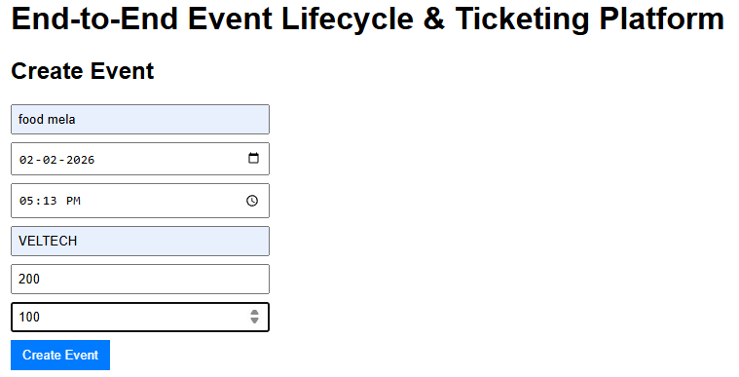
IMPLEMENTATION SCREENSHOTS
1
2
3
4
5
6
7
8
9
Explanation:
The home page provides an overview of the system with navigation options like Login, Register, and Information. It offers a user-friendly interface for easy access.

Slide 11
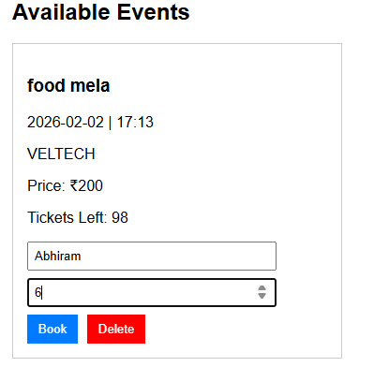
IMPLEMENTATION SCREENSHOTS
1
2
3
4
5
6
7
8(A)
9
Explanation:
This screenshot shows the dashboard where the client can choose to start the online booking.Each card displays details like number of seats, duration, and level with a secure logout option.

Slide 12
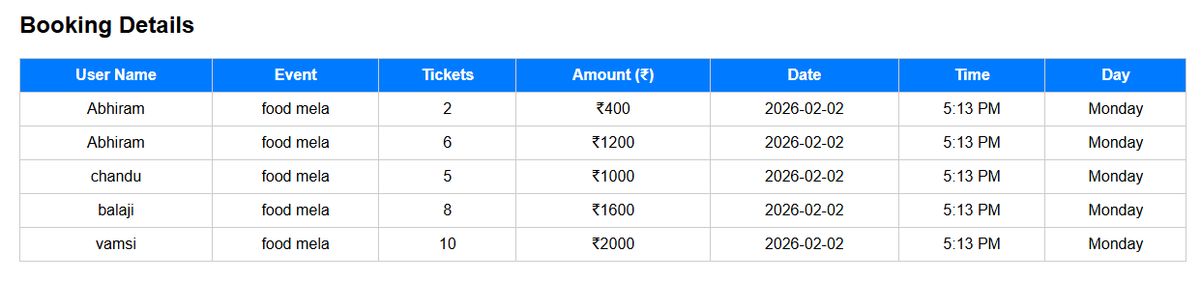
IMPLEMENTATION SCREENSHOTS
1
2
3
4
5
6
7
8(B)
9
Explanation:
This page displays dynamically with options organizer dashroad.and scanner to access the app defauls and navigation controls for submitting answers.

Slide 13
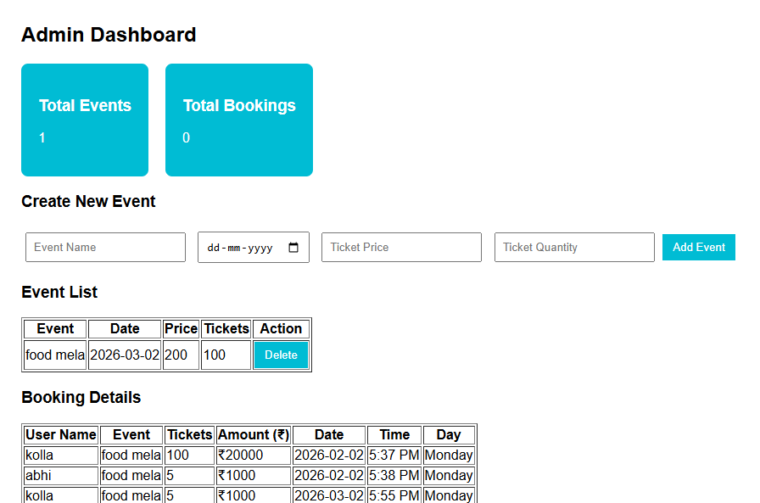
IMPLEMENTATION SCREENSHOTS
1
2
3
4
5
6
7
8(C)
9
Explanation:
The page shows admin portal, performance summary, and detailed score analysis.

Slide 14
ADVANTAGES & LIMITATIONS
1
Advantages:
All tickets are in one system, regardless of source (email, chat, phone, web)..
Automated routing sends tickets to the right team or agent immediately.
Ensures secure login and minimizes chances of paper leakage.
SLA tracking ensures urgent issues are prioritized.
Reduces manual intervention and delays.
2
3
4
5
6
Limitations:
Enterprise-grade platforms like ServiceNow can be expensive.
Poor adoption can reduce effectiveness.
➢Basic security implementation.
Enterprise-grade platforms like ServiceNow can be expensive.
7
8
9

Slide 15
Thank you

